Slide 1
Test Driven Development: It’s a Thing!
Chris Morton

Slide 2
Why We Are All Here—The Plan!
Introductions
What is TDD?!?
Why do I care about it?
Foundational definitions
Internal vs External Code Quality
Unit Testing
SOLID
Interface Abstraction w/ Polymorphism
Dependency Injection
Test Driven Development (TDD)
How do I do it?
Demo
Lab (time and interest permitting)

Slide 3
Wait… Who Are You??
Twitter and GitHub: @CMorton9249
Email: christopher_r_morton@progressive.com
LinkedIn: https://www.linkedin.com/in/christopher-morton-89388878/
Slide deck will be made available after the presentation

Slide 4
“When evaluating whether to buy or build, it's critical to thoroughly understand total costs during the software lifecycle -- typically seven or eight years. This step is important because 70 percent of software costs occur after implementation…"
– Mark Lutchen - former global CIO of PricewaterhouseCoopers, now head of the firm’s IT Effectiveness practice. (InfoWorld, 2006)

Slide 5
What makes “good” software?
User
Developer
Does it work?
Is it easy to use?
Does it look good?
Does it work?
Is it easy to use?
Does it look good?
How hard is it to work on?

Slide 6
TDD: Making Dev Better Since Before It Was Cool
Test Driven Development is the practice of iterative object oriented programming first introduced by Ken Beck in 2003.
When asked directly about the origins of TDD, Ken Beck shared that the roots of the technique were based on coding practices from 1957.
Built on the premise of a creating the shortest possible “feedback loop” for the developer to know whether they are on the right track, then reacting to that feedback to refine the design.
Red > Green > Refactor

Slide 7
Internal vs External Code Quality
External Code Quality: The measurement of a codebase in regards to its functionality.
Does it do what is expected, when it is expected, to an acceptable level of performance.
Internal Code Quality: The measure of a codebase in regards to its structure.
Is the codebase well organized, easy to work on, and flexible to change.

Slide 8
Let’s Talk About Unit Testing
The purpose of unit testing is to exercise the smallest possible unit of work in your code.
In most cases, this represents a single method.
Isolating dependencies is critical to success
Tests are short
Tests are easy!!!
If your test is hard to write, it is probably because your code lacks internal code quality

Slide 9
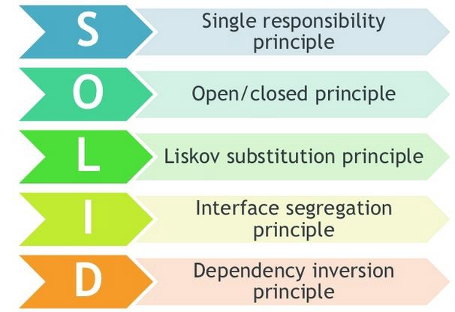
Where it all begins… SOLID Code
Maintainable software is:
Loosely coupled
Highly cohesive
Flexible
Durable
SOLID in C#.NET
Short read on SOLID

Slide 10
The ID in SOLID in 2 minutes…
Interface Segregation Principle^{[1]} states that no client should be forced to depend on methods it does not use
Dependency Inversion Principle^{[1]} states that:
High-level modules should not depend on low-level modules. Instead, both should rely on abstractions
Abstractions should not depend on details. Details should depend on abstractions.

Slide 11
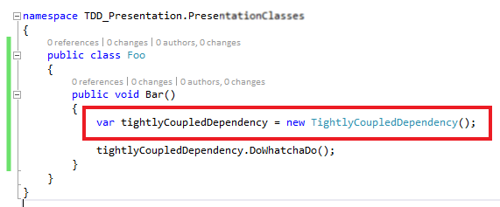
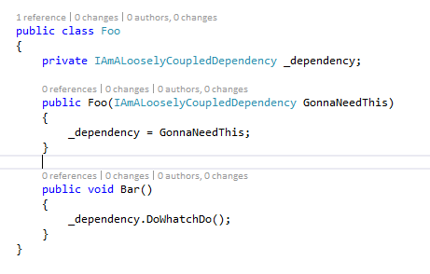
Dependency Injection w/ Interfaces
Encapsulating functionality into highly cohesive classes
Expressing functionality by abstractions vs concrete implementation
Made possible by polymorphism

Slide 12
What Does This Have To Do With TDD?
Dependency Injection is the first, most powerful tool available to you in isolating your System Under Test
Without good isolation, unit testing is extremely difficult
Encapsulated, highly cohesive, isolated code → Testable Code

Slide 13
Mocking… You can’t TDD without it…
Mocking/Stubbing is the practice of separating dependencies from the system under test by providing known results
Any abstracted functionality can be mocked.
Unit tests fall victim to any dependency outside explicit control.

Slide 14
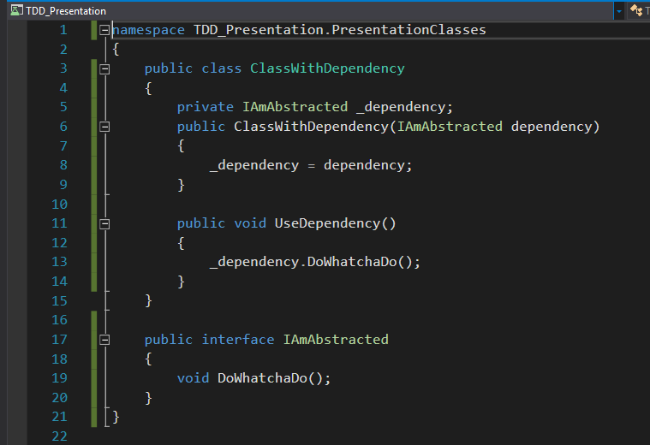
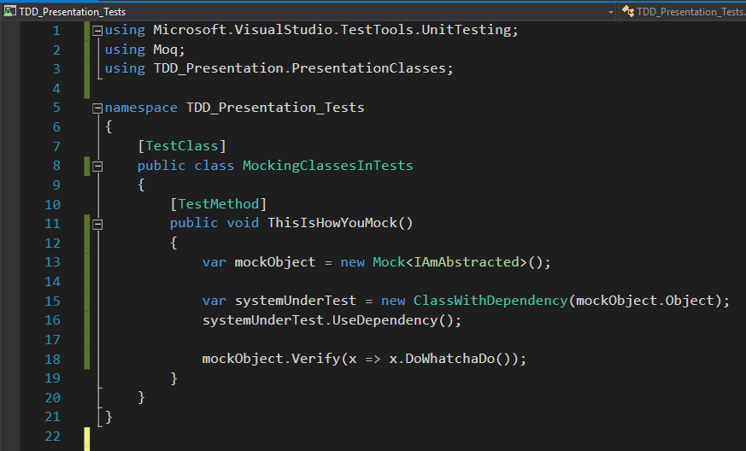
Mocking C#

Slide 15
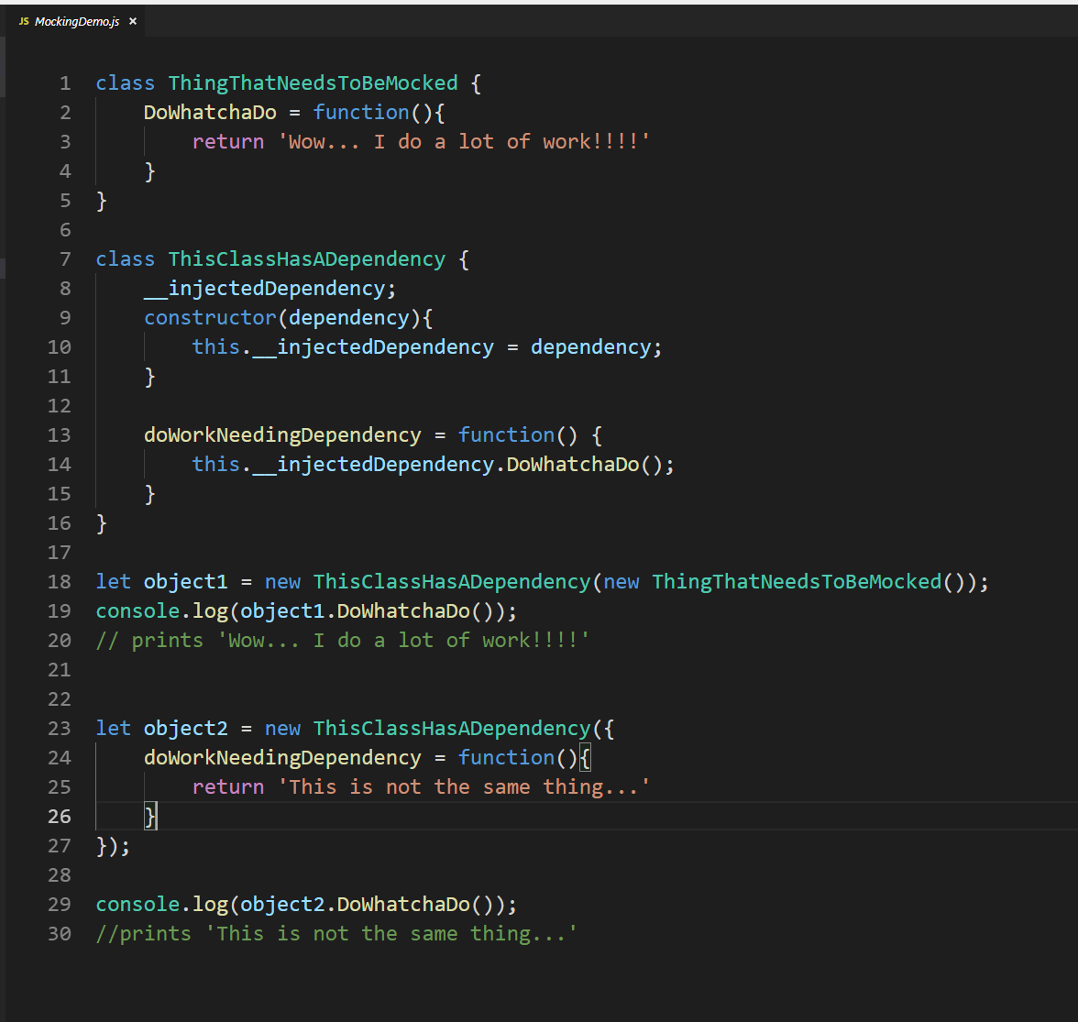
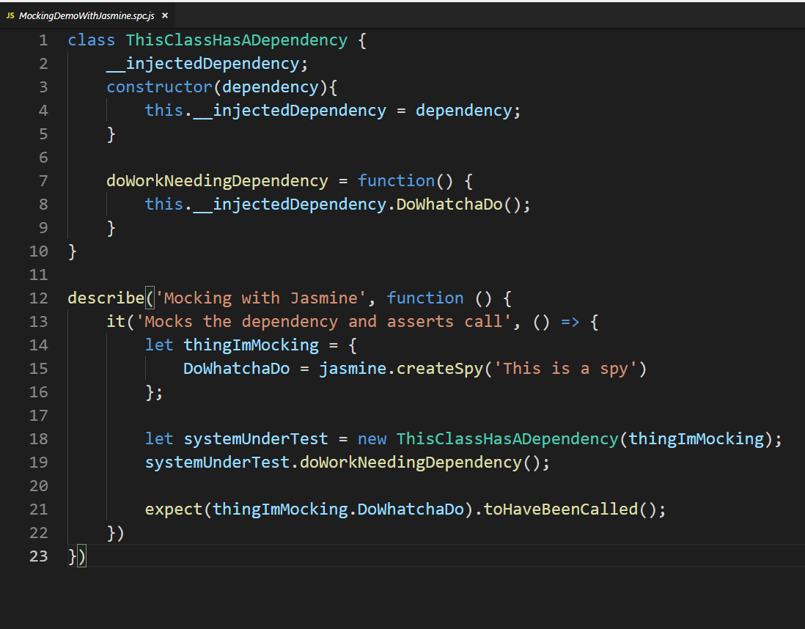
Mocking JavaScript

Slide 16
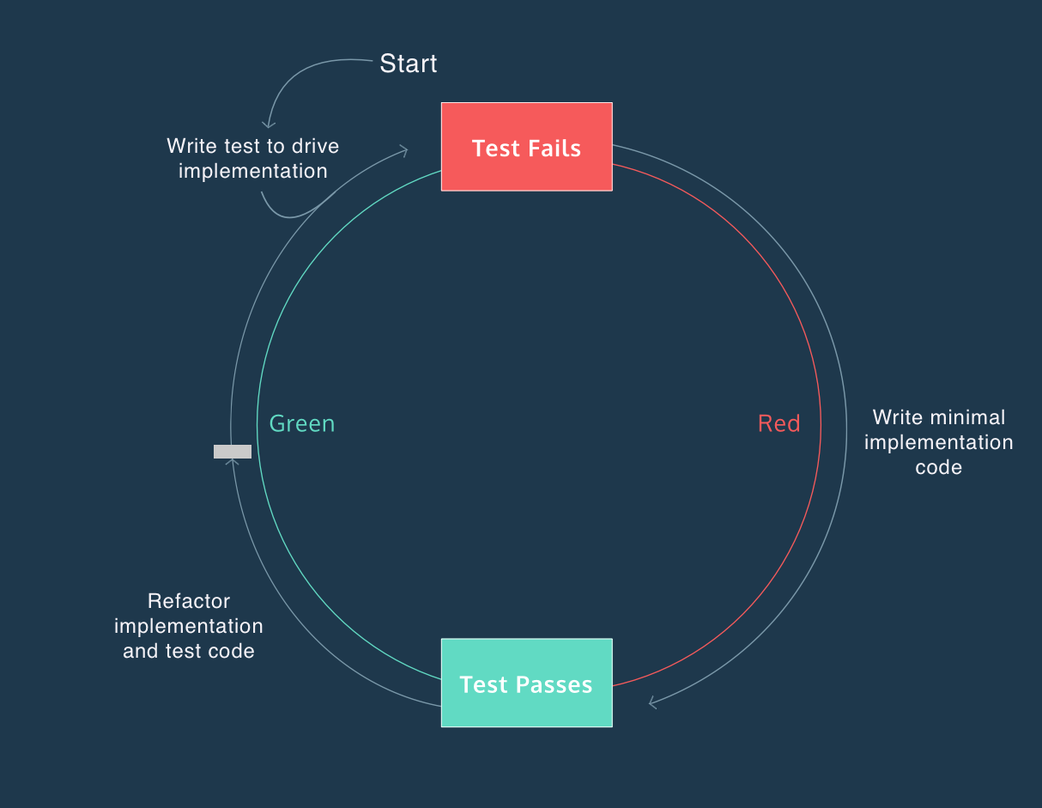
So How Do I TDD?!?
“Test the code you wish you had”
Red ➔ Green ➔ Refactor
Make the test fail
Make the test pass in the simplest way possible
Make the code better
If you don’t have a test for the code you are writing, you aren’t TDD.
Image sourced from: https://www.codecademy.com/articles/tdd-red-green-refactor

Slide 17
TDD Feels Weird At First
Compilers will fight with you. Their job is to stop you from writing code that doesn’t work.
If a problem is really hard, it is difficult to express the steps I tests.
Legacy code isn’t always conducive to TDD. You may not be able to separate those concerns.
It is only refactoring if the structure changes without the functionality. Otherwise, it is just coding

Slide 18
Sliming Code
“Sliming” code is a coined term meaning “hard code behavior you KNOW can’t last.
In TDD, we slime code because we don’t have a test for that condition yet.
Everyone’s tolerance for slime is different but, at some point, everyone must scrape the slime off!
Write tests to force you to scrape the slime

Slide 19
The Feedback Loop: RED → GREEN → Refactor
The feedback look is the core of TDD. Without it, the value is lost.
To make the process work, remember a few simple tips:
Don’t test the compiler
A compile time error is not a failure. It is an incomplete test.
Meaningful failures (a test that fails on an assert), represents the completion of the RED step.
You want to get from Red to Green in the least amount of time possible. It’s okay to slime your code.
Never skip the refactor. Otherwise, you just end up with hacky code.

Slide 20
LET’S TRY IT!!!
First, I’m going to show you an example using the FizzBuzz Exercise.
We will time box this demo to make sure we have time for Q&A/Lab

Slide 21

Questions?!?

Slide 22
References
[1] Martin, Robert C. Agile Software Development, Principles, Patterns, and Practices. 1st ed., Pearson, 2002.
[2] TDD String Calculator Kata: http://osherove.com/tdd-kata-1/

